Slide 1
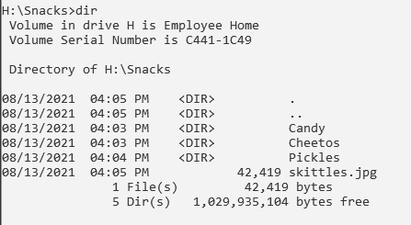
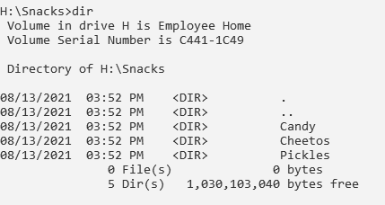
Current Directory
Folders
Parent Directory

Slide 2
See what’s here - look around | dir
Change location | cd folderName
Go back one step | cd..
Make a new folder | mkdir folderName
Delete folder | rmdir folderName
Move something | move skittles.jpg Candy
Clear my screen | cls
What to move
Where to move

Slide 3
Click on the Student Share Drive S - Green folder - Your Class Period - Zoo_Animals
Copy this file and navigate to your H Drive. Paste it there. Do not put it inside another folder like Cyber, just paste it on your H drive.
If you have forgotten how to do that please watch this tutorial.
CopyFromShareDrivetoHDrive

Slide 4
Screenshot 1:
Change location to the Zoo_Animals folder.
See what’s here
Go to the Elephants folder
See what’s here
Go back one step
See what’s here
move dumbo.jpg Elephants
Change location Elephants folder.
See what’s here
move dumbo.jpg BabyElephants
Change location to BabyElephants folder.
See what’s here
Take a screenshot from inside the baby elephants folder on the command line and paste on next slide:

Slide 5
Paste Screenshot 1 below:

Slide 6
Screenshot 2
Clear your command line screen
You should still be in BabyElephants folder
Go back one step
Go back one step
Change location Lions folder.
mkdir babyLions
Go back one step
move simba.jpg Lions
Go to Lions folder
move simba.jpg babyLions
Go back one step
Try going to an exact location from Zoo_Animals type: cd Lions\babyLions
see what’s here - we should see the simba.jpg here
Take a screenshot from inside the baby lions folder on the command line and paste on next slide:

Slide 7
Paste Screenshot 2 below:

Slide 8
Screenshot 3
Clear your command line screen
You should still be in babyLions folder
Go back to zoo animals folder - hint take 2 steps back
See what’s here
Make a new folder called Tigers
Change location to Tigers folder
make a new folder called babyTigers type: mkdir babyTigers
change location to zoo animals
move tony.jpg Tigers\babyTigers
go to babytiger folder
see if tony.jpg is in there
Take a screenshot from inside the baby tiger folder on the command line and paste on next slide:

Slide 9
Paste Screenshot 3 below:

Slide 10
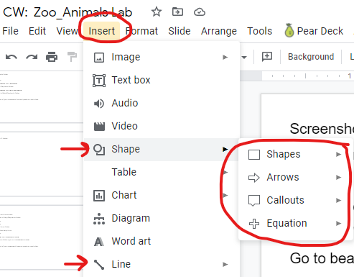
Screenshot 4
Clear your command line screen
You should still be in babytiger folder
Go back to zoo animals folder
See what’s here
Go to bears folder
See what’s here
Take a screenshot of this view and paste below on next
slide then label using shapes
Label the folders
Label files
Label current directory
Label parent directory

Slide 11
Paste Screenshot 4 below and label all 4 items:

